Slide 1
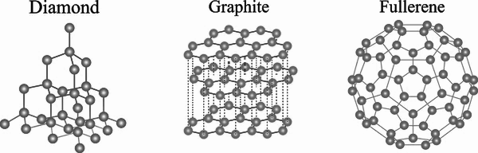
Giant Covalent Structures
Unit 2
Lesson 7
C₆₀

Slide 2
Starter: recap of molecular substances
Give 3 examples of some molecular substances.
State how molecular substances are bonded.
What state of matter are most molecular substances at room temperature?
Explain why molecular substances have low boiling points.
hydrogen, oxygen, nitrogen, iodine, water, carbon dioxide
Covalent bonds
Mostly gases (although there are some liquids and solids)
There are weak intermolecular forces between the different molecules which do not require much energy to overcome.

Slide 3
Today’s Aim
Unit 2
Lesson 7
By the end of this lesson I will be able to state and explain the properties of giant covalent structures

Slide 4

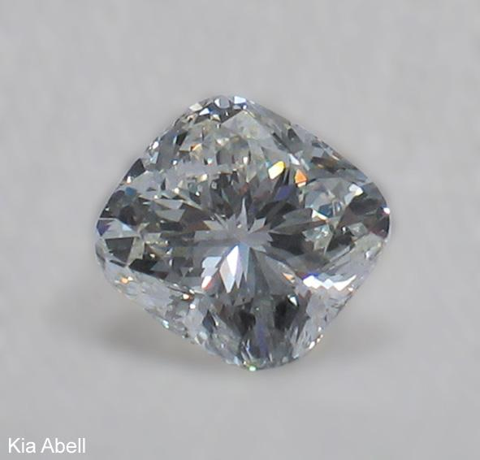
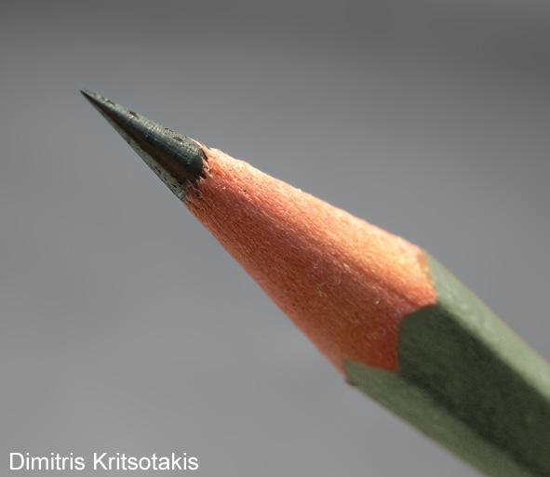
Giant covalent structures
In some substances, such as sand, diamond and graphite, billions of atoms are joined together by covalent bonds.
The resulting structure of these substances is not molecular, instead the billions of atoms form vast networks called giant covalent structures.

Slide 5

Giant covalent structures
The general properties of giant covalent structures are:
Very hard and strong.
High melting and boiling point – a lot of energy is needed to break the many covalent bonds - and so they are all solid at room temperature.
Non conductors due to no ions and no free electrons

Slide 6

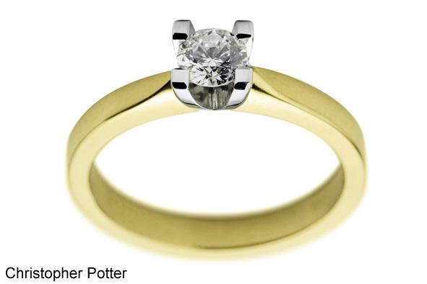
Allotropes of carbon
Diamond and graphite appear to be very different substances but they are both made up of just carbon!
carbon
Different forms of the same element are called allotropes. These allotropes of carbon have different properties because the atoms are bonded in different arrangements which create different giant structures.

Slide 7
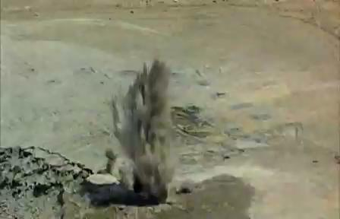
Allotropes of carbon

Slide 8
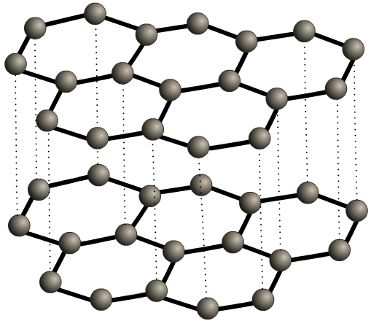
Properties of graphite
In graphite, only three of the four electrons in the outer shell of each carbon atom are involved in covalent bonds. This means:
Graphite is soft and slippery – layers can easily slide over each other because the weak forces of attraction are easily broken. This is why graphite is used as a lubricant.
Graphite conducts electricity – the only non-metal to do so. The ‘free’ electron from each carbon means there are delocalised electrons that can carry charge.

Slide 9
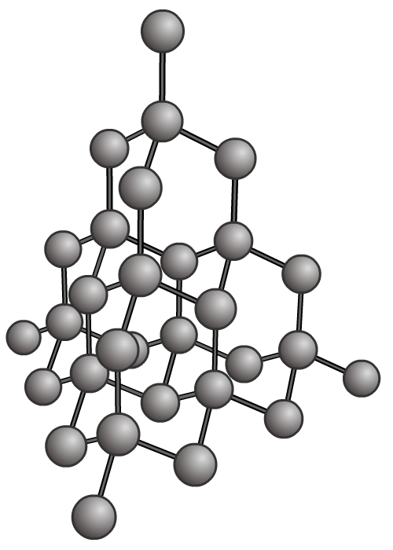
Properties of diamond
In diamond, all four electrons in the outer shell of each carbon atom are involved in forming covalent bonds which affects the properties of this allotrope of carbon:
Diamond is very hard – the hardest natural substance.
Diamond has a very high melting and boiling point – a lot of energy is needed to break the covalent bonds.
Diamond, like most giant covalent structures cannot conduct electricity as there are no free electrons or ions to carry a charge.

Slide 10
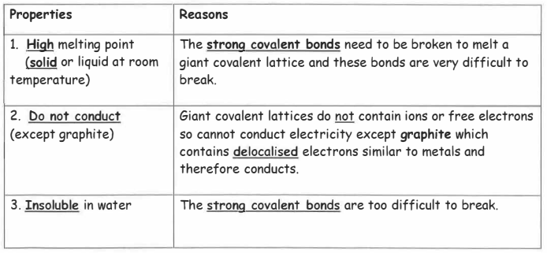
Summary of giant covalent structures - page 37

Slide 11
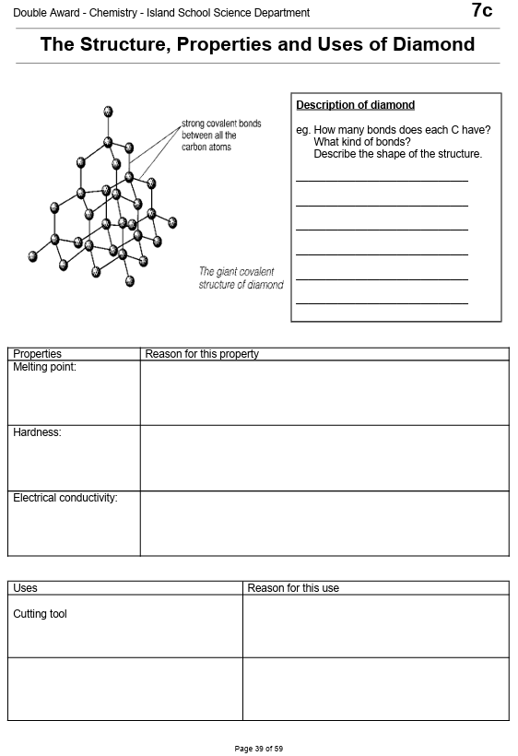
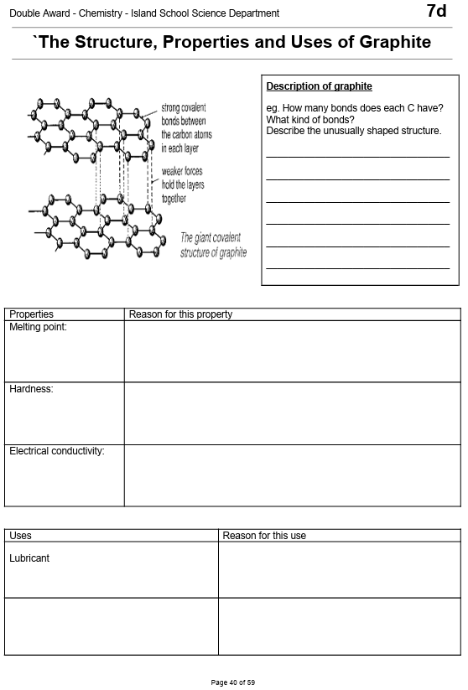
Complete worksheets on
page 39 (diamond)
and
page 40 (graphite)

Slide 12
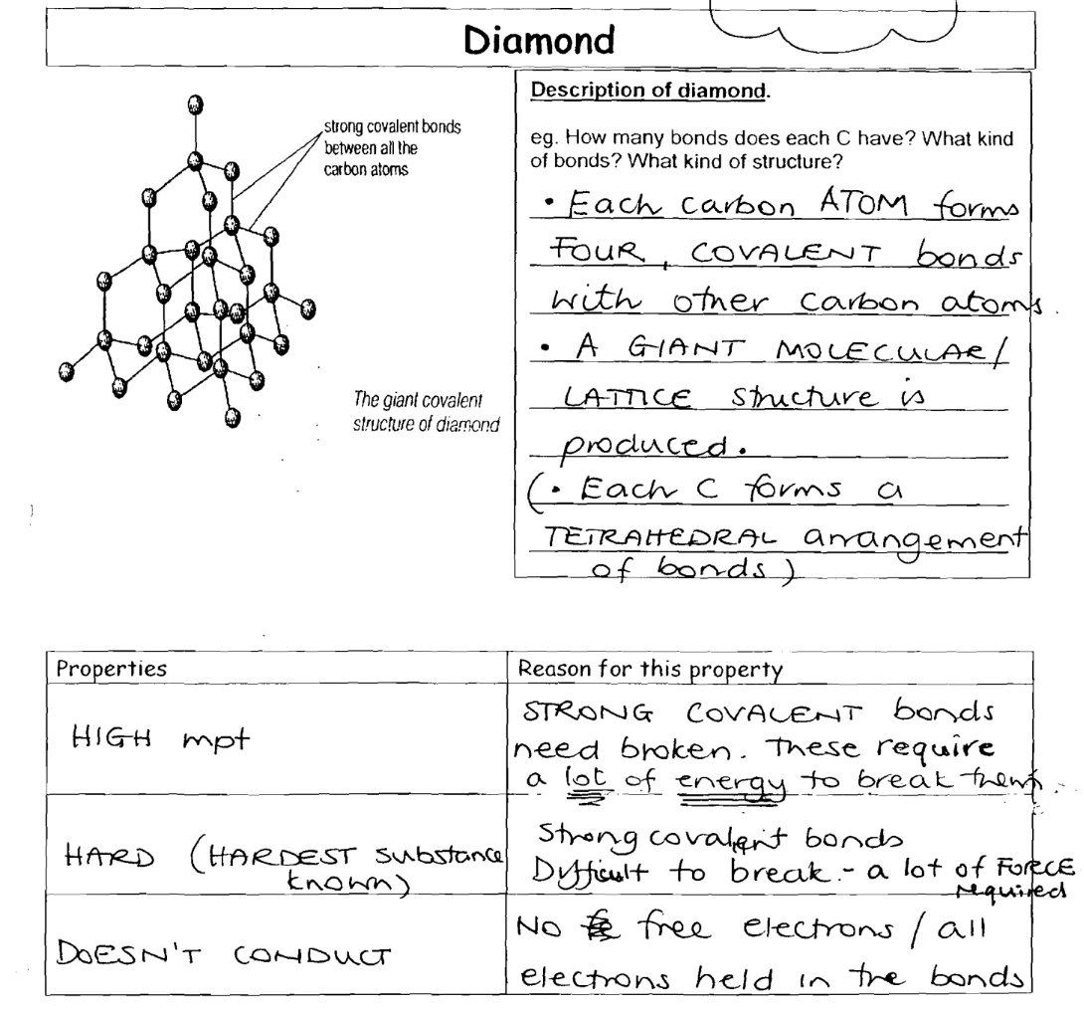
Graphite

Slide 13
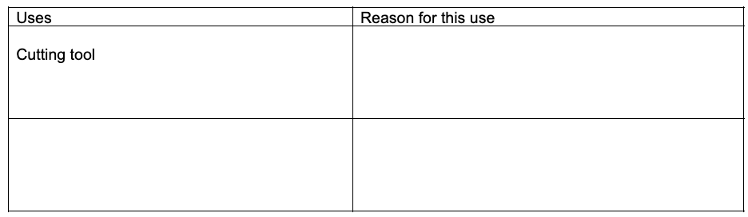
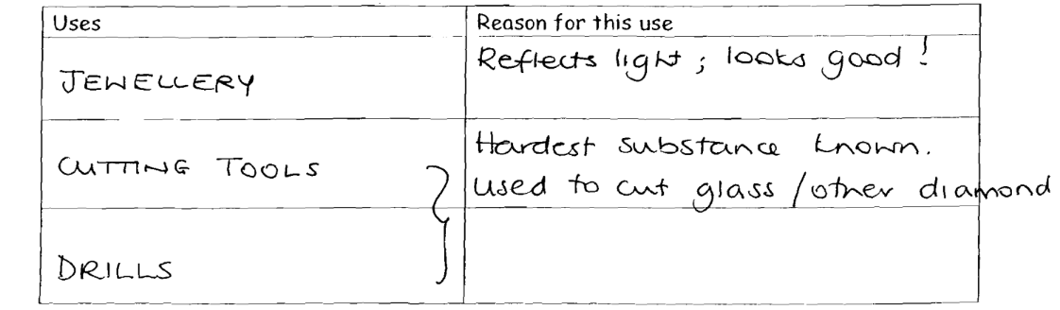
Diamond

Slide 14
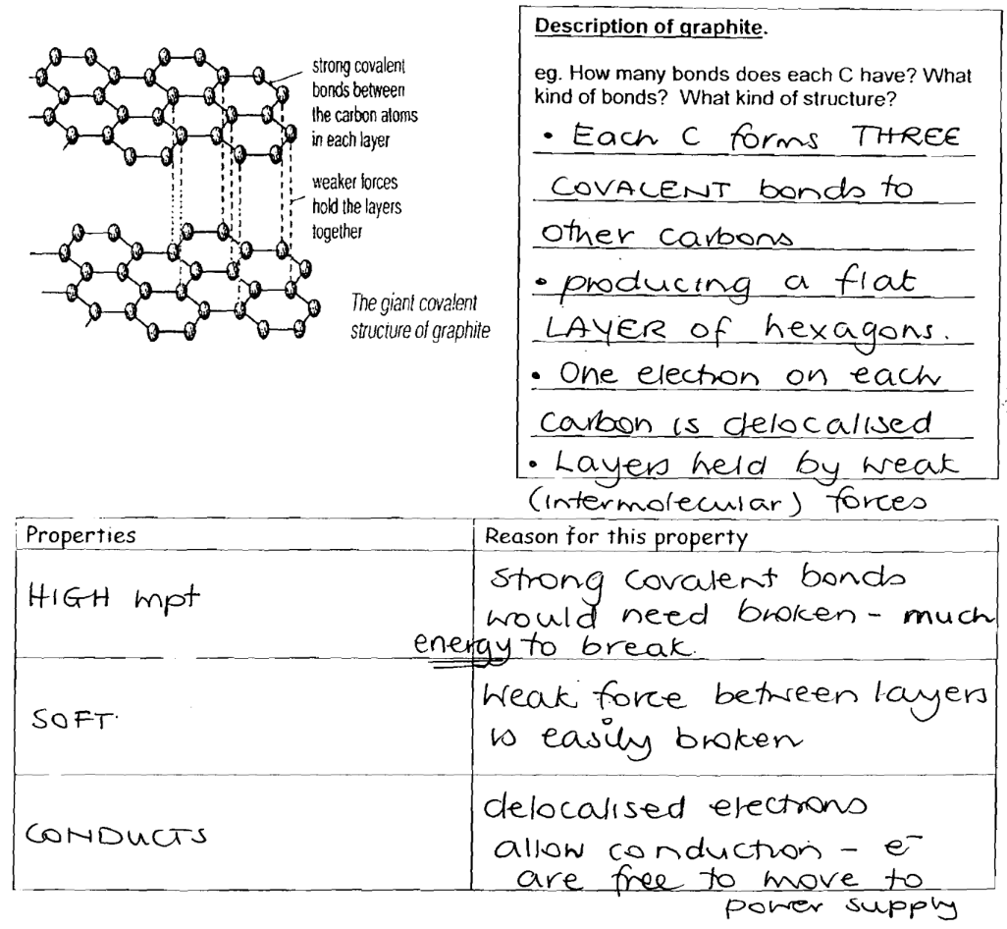
Graphite

Slide 15
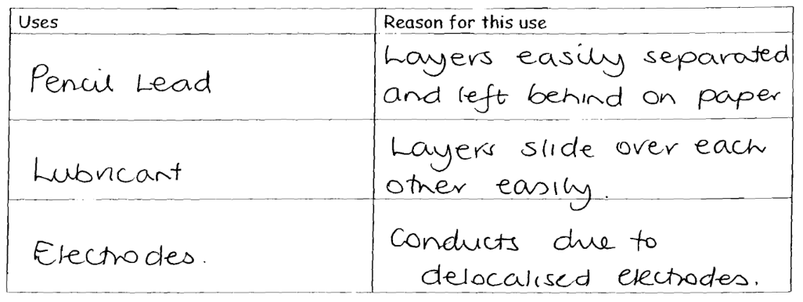
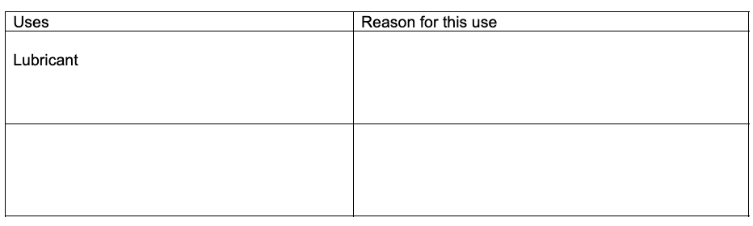
Graphite

Slide 16
Covalent Structures
C₆₀
Note that both diamond and graphite have a vast lattice network with billions of atoms. They have giant covalent structures.
The next substance to learn about is called C₆₀ fullerene. It has only 60 atoms of carbon in its structure. It therefore has the properties of molecular structures

Slide 17
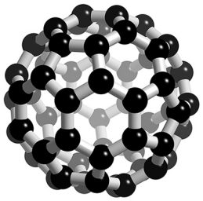
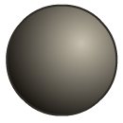
C₆₀ fullerene
Buckminsterfullerene, C₆₀, is one type of fullerene. It contains 60 carbon atoms, each of which is bonded to three others by two single bonds and one double bond.
C
C
C
C
The atoms in this allotrope of carbon form a sphere, like the shape of a football. The molecules can be called ‘bucky balls’. They are large but still count as molecular substances as they have relatively few atoms.

Slide 18
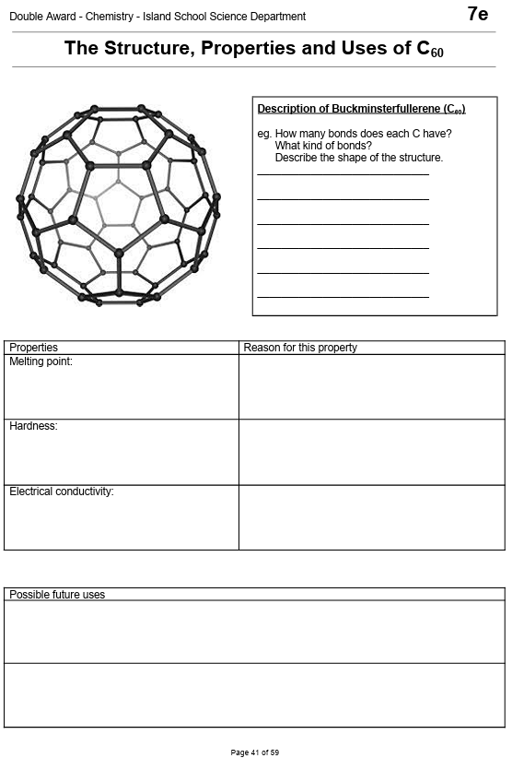
Complete the worksheet on page 41

Slide 19
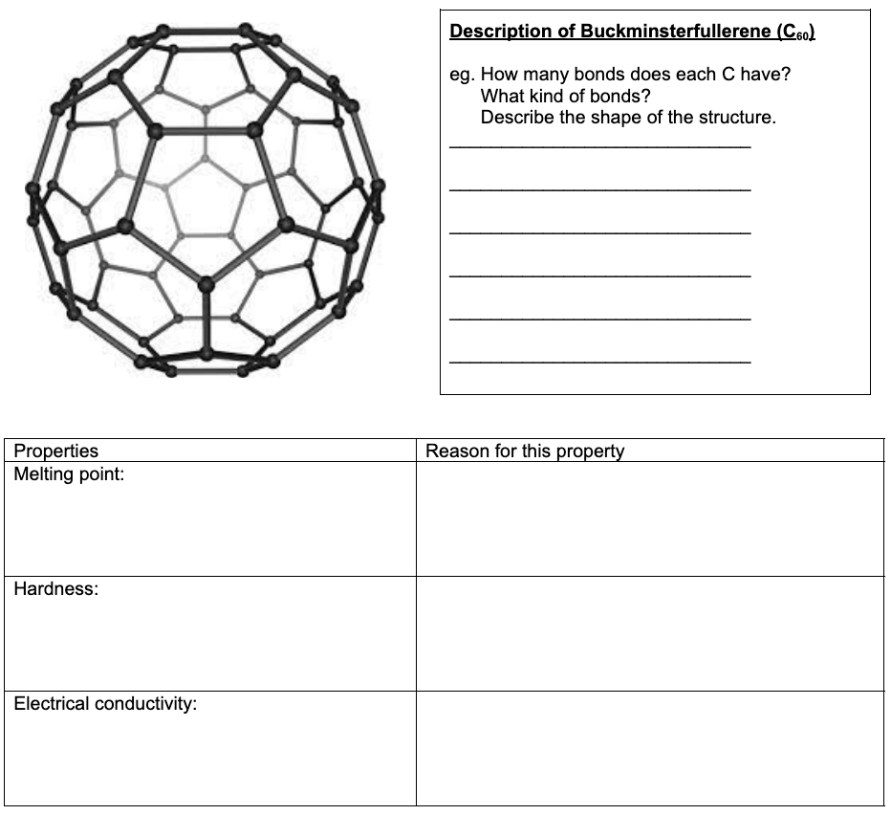
C₆₀ fullerene
Each carbon atom forms 3 covalent bonds to other carbon atoms. In this fullerene, 60 carbon atoms are joined together forming 20 hexagons and 12 pentagons which produce a hollow sphere that is the exact shape of a soccer ball
There are weak intermolecular forces between individual buckyballs
Little energy is needed to overcome these forces
Covalent bonds are strong
Although the fourth electron in C60 is not bonded, the electrons are only freely moving within the buckyballs and cannot migrate from one buckyball to another, so C60 does not conduct electricity

Slide 20
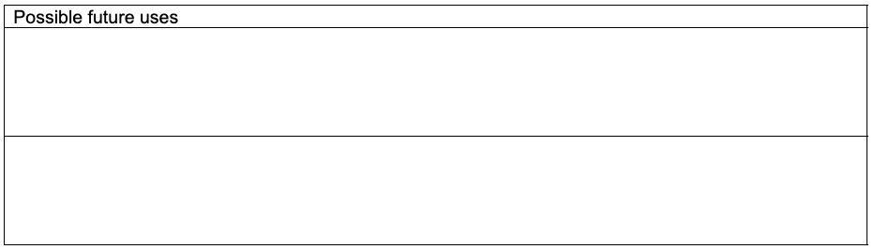
C₆₀ fullerene
Fullerenes can be used to trap other molecules by forming around the target molecule and capturing it, making them useful for targeted drug delivery systems
They also have a huge surface area and are useful for trapping catalyst molecules onto their surfaces making them easily accessible to reactants, so catalysis can take place
Some fullerenes are excellent lubricants and are starting to be used in many industrial processes

Slide 21
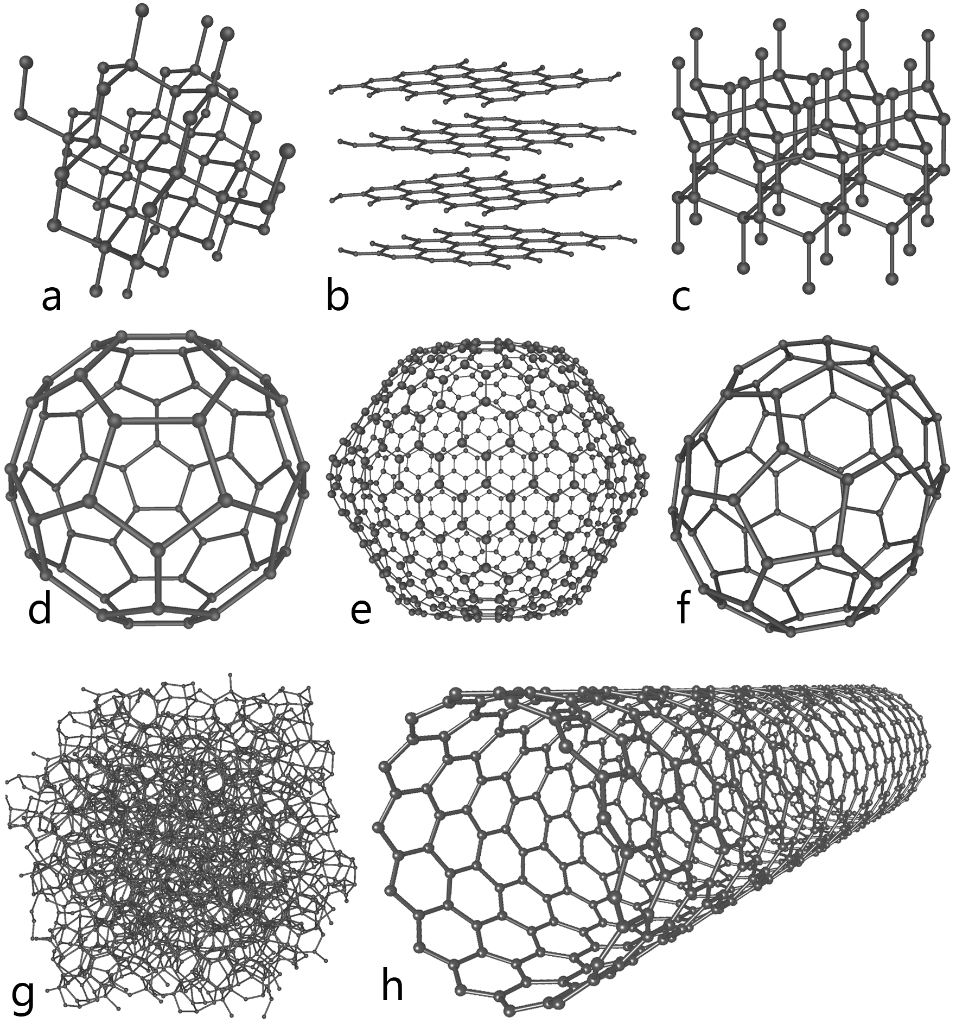
There are many carbon allotropes
Some allotropes of carbon:
Diamond
Graphite
Lonsdaleite
d-f) fullerenes; C₆₀, C₅₄₀ and C₇₀
amorphous carbon
carbon nanotube

Slide 22
Plenary: covalent comparisons
 | Molecular covalent | Giant covalent lattice
Type of bonding | covalent | covalent
Number of atoms | Few (2, 3, 4+) | Lots (bizillions, gizzilions, qwadrizilions)
State at room temperature | Mainly gases (some liquids and solids) | Solid
Why this state? | Weak intermolecular forces between individual molecules | Vast numbers of strong covalent bonds in all directions
What’s this got to do with energy? | Only a small amount of energy is needed to overcome these forces of attraction and so room temperature is enough to boil them into gases | A lot of energy is needed to break all these bonds and so they remain solid at room temperature
Examples | methane, water, hydrogen, oxygen | diamond, graphite, sand

Slide 23

What you need to know
Unit 2
Lesson 7
Syllabus Content
1.49
explain why substances with giant covalent structures are solids with high melting and boiling points.
1.50
explain how the structures of diamond, graphite and C₆₀ fullerene influence their physical properties, including electrical conductivity and hardness.
1.51
know that covalent compounds do not usually conduct electricity.
My Learning

